Slide 1
AP Stats Chapter 9 Review
Sampling Distributions

Slide 2
In a study of the effects of acid rain, a random sample of 100 trees from a particular forest is examined. Forty percent of these show some signs of damage. Which of the following statements is correct?
a) 40% is a parameter
b) 40% is a statistic
c) 40% of all trees in the forest show some signs of damage
d) More than 40% of the trees in the forest show some signs of damage
e) Less than 40% of the trees in the forest show some signs of damage
Parameters are characteristics of the population. Statistics are characteristics of a sample. Since 40% of the sample show signs of damage, it is therefore a “statistic”

Slide 3
Refer to the previous problem. Which of the following statements is correct?
a) The sampling distribution of the proportion of damaged trees is approximately Normal
b) If we took another random sample of trees, we would find that 40% of these would show some signs of damage
c) If a sample of 1000 trees was examined, the variability of the sample proportion would be larger than in a sample of 100 trees
d) This is a comparative experiment
e)None of the above
According the Central limit theorem, the sampling distribution of the proportion of damaged trees will be approximately normal. The conditions required are n x p > 10

Slide 4
Which of the following statements is/are true?
The sampling distribution of has standard deviation even if the population is not normally distributed
The sampling distribution of is Normal if the population has a Normal distribution
When “n” is large, the sampling distribution of is approximately normal even if the population is not Normally distributed

Slide 5
Suppose we are planning on taking an SRS from a population. If we double the sample size, then what constant will the standard error be multiplied by?

Slide 6
If a statistic used to estimate a parameter, such that the mean of its sampling distribution is different from the true value of the parameter being estimated, the statistic is said to be
a) Random
b) Biased
c) A proportion
d) Unbiased
e) None of the above. The answer is ______________

Slide 7
A machine is designed to fill 16-ounce bottles of shampoo. When the machine is working properly, the mean amount poured into the bottles is 16.05 ounces with a standard deviation of 0.1 ounce. If four bottles are randomly selected each hour and the number of ounces in each bottle is measured, then 95% of the observations should occur in which interval?
(a) 16.05 and 16.15 ounces
(b) –0.30 and +0.30 ounces
(c) 15.95 and 16.15 ounces
(d) 15.90 and 16.20 ounces
(e) None of the above

Slide 8
Dr. Stats plans to toss a fair coin 10,000 times in the hope that it will lead him to a deeper understanding of the laws of probability. Which of the following statements is true?
a) It is unlikely that Dr. Stats will get more than 5000 heads.
b) When Dr. Stats gets a string of 15 tails in a row, it’s more likely the next toss will be a head.
c) The fraction of tosses resulting in heads should be close to 1/2.
d) The chance that the 100th toss will be a head depends on the results of the first 99 tosses.
e) All of the above statements are true

Slide 9
A vending machine offers 20-ounce bottles for $1.50. The number of bottles “X” bought from the machine on any day is a random variable with mean 50 and SD 15. Let the random variable “Y” equal the total revenue from this machine on a given day. Assume the machine works properly and that no sodas are stolen from the machine. What are the mean and SD of “Y”?

Slide 10
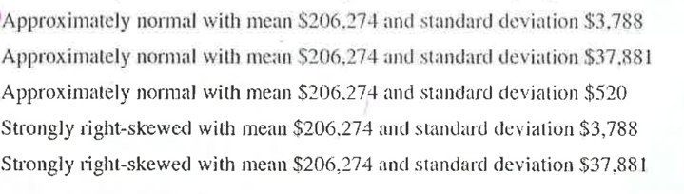
There were 5317 owned homes sold in a BC city in the year 2000. The distribution of the sales of these homes was strongly right-skewed, with a mean of $206,274 and a standard deviation of $37,881. If all possible SRS of size 100 are drawn from this population and the mean is computed for each off these samples, which of the following describes the sampling distribution of the sample mean?
a)
B)
c)
d)
e)

Slide 11
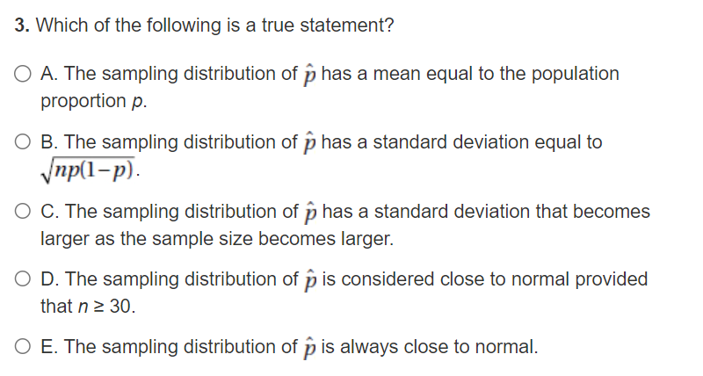

Slide 12

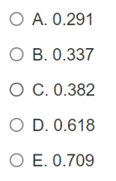

Slide 13
Q: A researcher wants to estimate the proportion of people who purchase a certain product online. The researcher originally planned to obtain a random sample of 2500 people who purchased the product. However, due to financial reasons, the sample size was reduced to 1250. Which of the following describes the effect of reducing the number of people in the sample size?
a) The variance of the sample will increase
b) The variance of the population will decrease
c) The variance of the sampling distribution of the estimator will increase
d) The variance of the sampling distribution of the estimator will decrease
e) The variance of the sampling distribution of the estimator will stay the same

Slide 14
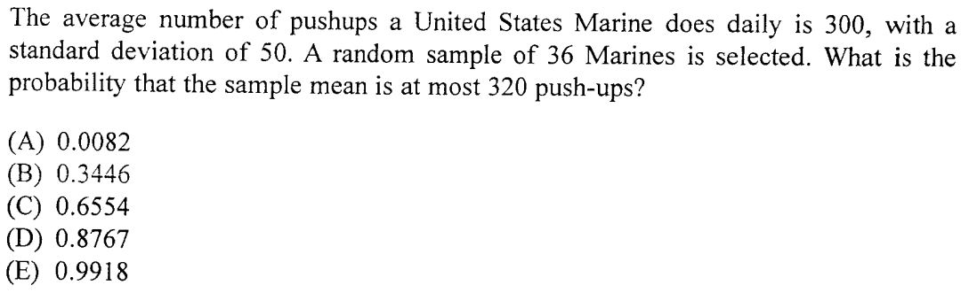

Slide 15
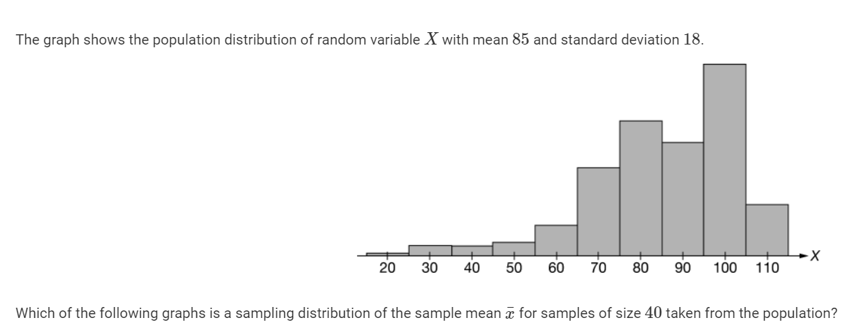
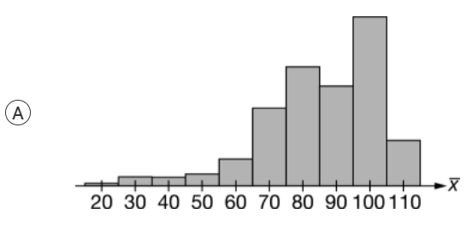
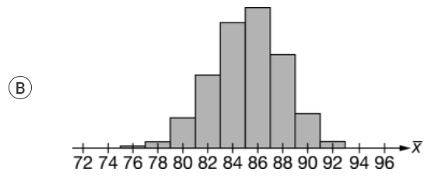
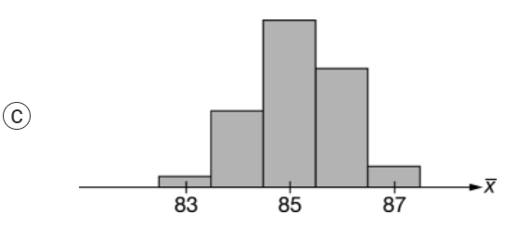
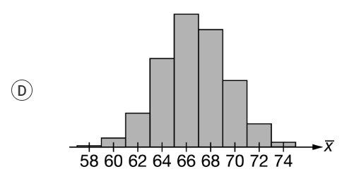
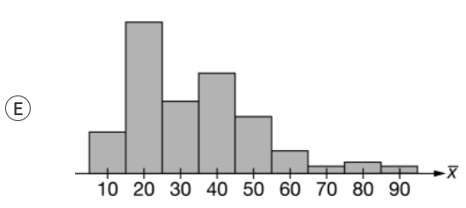

Slide 16
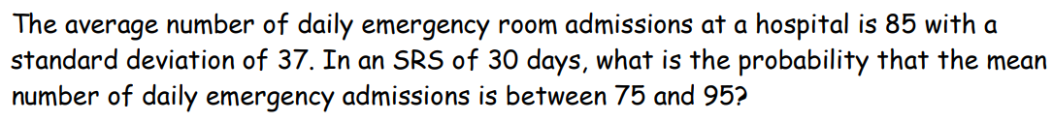
According to the Central Limit Thm, if the sample is n>30, then the distribution of the sample means will be normally distributed!

Slide 17
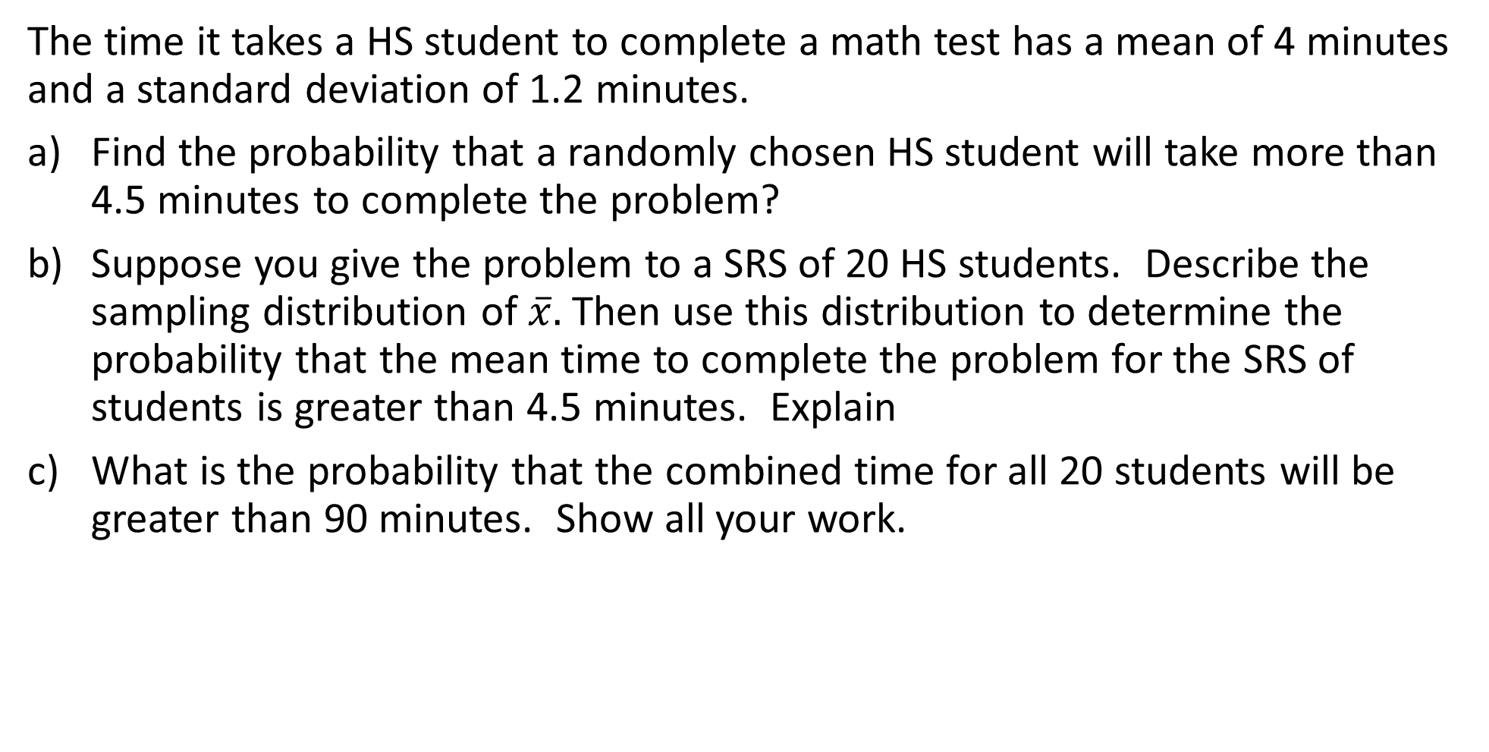
The time it takes a HS student to complete a math test has a mean of 4 minutes and a standard deviation of 1.2 minutes.
Find the probability that a randomly chosen HS student will take more than 4.5 minutes to complete the problem?
Suppose you give the problem to a SRS of 20 HS students. Describe the sampling distribution of $\overline{x}.$Then use this distribution to determine the probability that the mean time to complete the problem for the SRS of students is greater than 4.5 minutes. Explain
What is the probability that the combined time for all 20 students will be greater than 90 minutes. Show all your work.

Slide 18
A TV producer must fill 15 minutes of television time with advertisements. The lengths of advertisements are normally distributed with a mean of 28 seconds and std dev. Of 5s. To fill in the 15minutes, the producer fills it with 30 ads.
Describe the sampling distribution of the sample mean length for random samples of 30 advertisements
If 30 advertisements are randomly selected, what is the probability that the total time needed to air them will exceed the 15min available? Show how you will answer this question in TWO different ways.

Slide 19
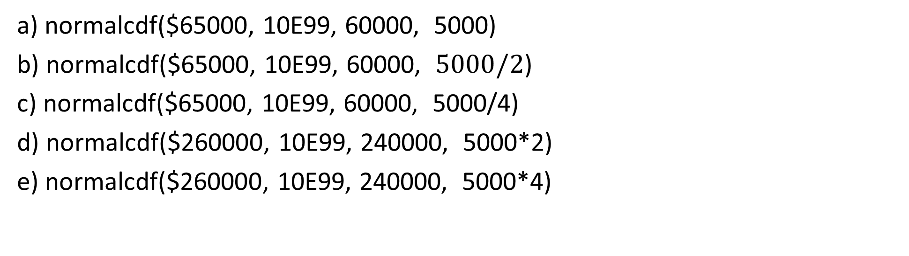
The incomes in a certain large population of teachers have a normal distribution with mean of $60,000 and std dev of $5000. Four teachers are selected at random from this population to serve a salary review. What is the probability that their average salary exceeds $65,000?
a) normalcdf($65000, 10E99, 60000, 5000)
b) normalcdf($65000, 10E99, 60000, $5000/2$)
c) normalcdf($65000, 10E99, 60000, 5000/4)
d) normalcdf($260000, 10E99, 240000, 5000*2)
e) normalcdf($260000, 10E99, 240000, 5000*4)

Slide 20
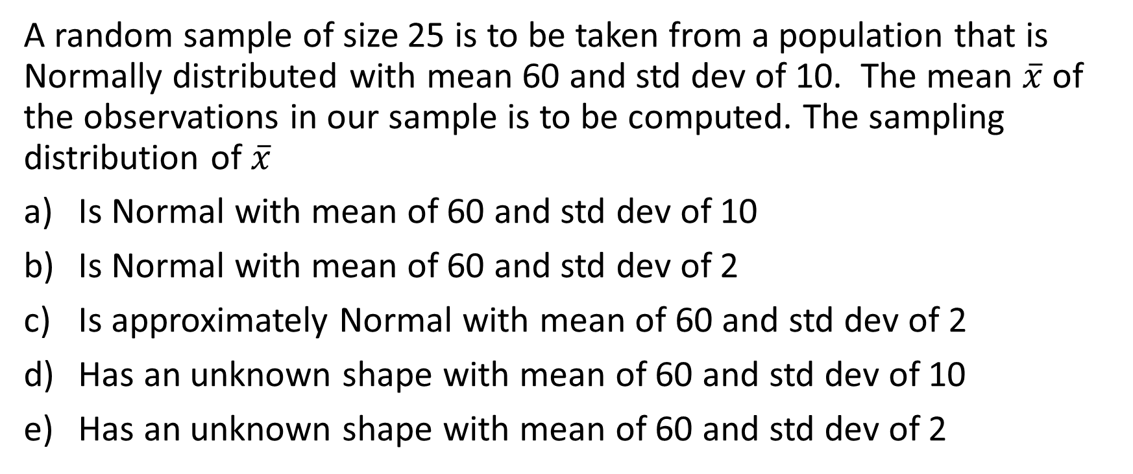
A random sample of size 25 is to be taken from a population that is Normally distributed with mean 60 and std dev of 10. The mean $\overline{x}$ of the observations in our sample is to be computed. The sampling distribution of $\overline{x}$
Is Normal with mean of 60 and std dev of 10
Is Normal with mean of 60 and std dev of 2
Is approximately Normal with mean of 60 and std dev of 2
Has an unknown shape with mean of 60 and std dev of 10
Has an unknown shape with mean of 60 and std dev of 2

Slide 21
The variability of a statistics is described by:
The spread of its sampling distribution
The amount of bias present
The vaguessness in the wording of the question used to collect the data
Probability calculations
The stability of the population it describes

Slide 22
According to a recent poll, 27% of Canadians prefer to read their paper physically than electronically. Let’s assume this is the parameter value for the population. If you take a simple random sample of 25 Canadians, is the shape of the distribution of the sample proportion approximately normal?
NO because p<0.50
No because np=6.75
Yes because we can reasonably assume there are mor than 250 individuals in the population
Yes because we took a SRS
YES, because n(1-p)= 18.25

Slide 23
The distribution of prices for home sales in Abbotsford is skewed to the right with a mean of $290,000 with std dev of $145,000. Suppose you take a simple random sample of 100 homes sales from this population. What is the probability that the mean of the sample is above $325,000?
0.0015
0.0027
0.0079
0.4046
0.4921

Slide 24
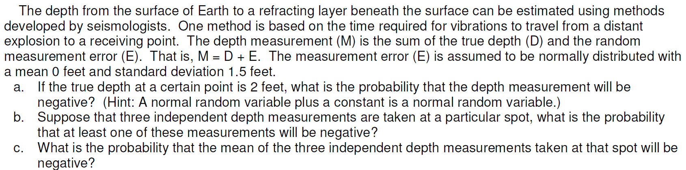

Slide 25
Which of the following statements are true?
I. The larger the sample, the larger the spread in the sampling distribution.
II. Provided that the population size is significantly greater than the sample size, the spread of a sampling distribution is about the same no matter what the population size.
III. Bias has to do with the center, not the spread of the sampling distribution.
(a) I and II (b) I and III (c) II and III (d) I, II, and III
(e) None of the above gives the complete set of true responses.

Slide 26
Which of the following statements are true?
I. Sample parameters are used to make inferences about population statistics.
II. Statistics from smaller samples have more variability.
III. Parameters are fixed, while statistics vary depending on which sample is chosen.
(a) I and II (b) I and III (c) II and III (d) I, II, and III
(e) None of the above gives the complete set of true responses

Slide 27
The average number of daily emergency room admissions at a hospital is 85 with a standard deviation of 37. In an SRS of 30 days, what is the probability that the mean number of daily emergency admissions is between 75 and 95?
(a) .1388 (b) .2128 (c) .8612 (d) .8990 (e) .9970

Slide 28
A statistic is said to be unbiased if
the survey used to obtain the statistic was designed so as to avoid even the hint of racial or sexual prejudice.
the mean of its sampling distribution is equal to the true value of the parameter being estimated
both the person who calculated the statistic and the subjects whose responses make up the statistic were truthful.
the value from any sample is equal to the parameter being estimated.
e) it is used for honest purposes only

Slide 29
In a large population of adults, the mean IQ is 112 with a standard deviation of 20. Suppose 200 adults
are randomly selected for a market research campaign. The sampling distribution of the sample mean IQ is
exactly Normal, mean 112, standard deviation 20.
approximately Normal, mean 112, standard deviation 0.1.
approximately Normal, mean 112, standard deviation 1.414.
approximately Normal, mean 112, standard deviation 20.
e) exactly Normal, mean 112, standard deviation 1.414

Slide 30
Which of the following best describes a sampling distribution?
The distribution of all values of a statistic found in a large number of simulated samples of size n.
The set of all values of a variable in a sample of size n.
The set of all values of a variable in a large number of samples of size n.
The distribution of parameter values in all possible samples of size n.
e) A probability distribution that describes the relative likelihood of all possible values of a statistic

Slide 31
Suppose you are sampling from a distribution that is strongly skewed left. Which of the following statements about the sampling distribution of the sample mean is true?
As the sample size increases, the shape of the sampling distribution gets closer and closer to a Normal distribution.
As the sample size increases, the shape of the sampling distribution gets closer and closer to the shape of the population distribution.
As the sample size increases, the mean of the sampling distribution gets closer to the population mea
Regardless of the sample size, the shape of the sampling distribution is similar to the shape of the population distribution.
Regardless of the sample size, the standard deviation of the sampling distribution is approximately equal to the standard deviation of the population

Slide 32
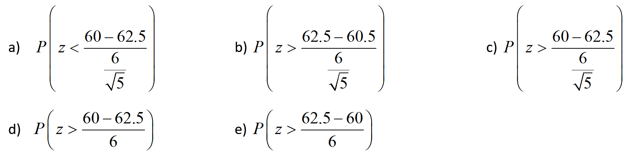
Interpupillary distance (IPD) is the distance between the centers of the pupils of a person’s left and right eyes. In adult males IPD is approximately Normally distributed wit ha mean of 62.5mm and a SD of 6mm. Suppose you randomly select 5 male adults, what is the probability that their mean IPD is greater than 60mm?

Slide 33
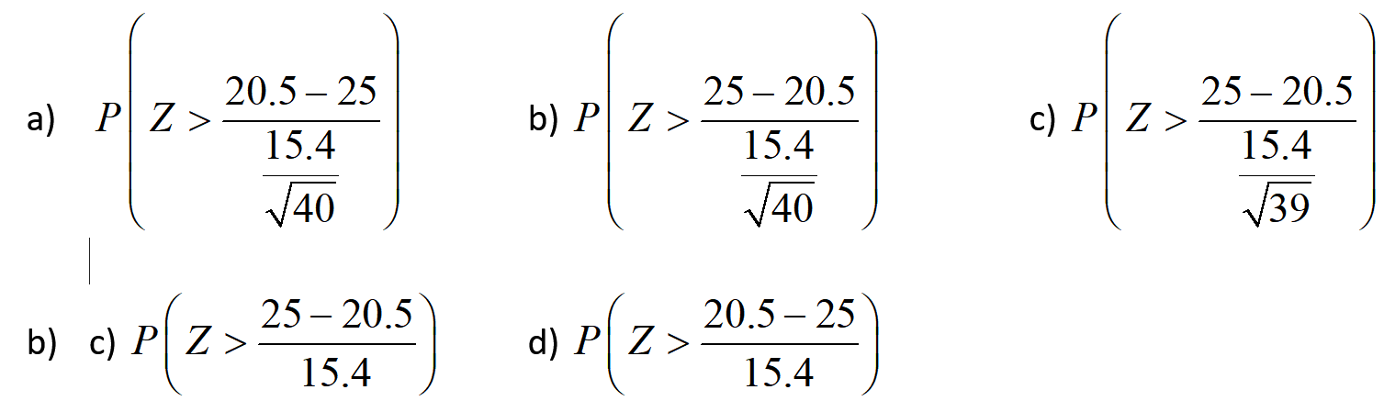
A census of the labor force in a cit found that the time it takes for people to commute to work has a mean of 20.5 minutes and a SD of 15.4 minutes. What is the probability that a random sample of 40 people have a mean commute time that is greater than 25 minutes?

Slide 34
53% of adults say they have trouble falling asleep. If a nurse contacts an SRS of 85 adults, what is the probability that over 55% will say they have trouble sleeping?
a) 31.09% b) 35.58% c) 36.4%
d) 40% e) 64.42%

Slide 35
The owner of a coffee shop advertises the price of coffee on any given day will be randomly picked using a normal distribution with mean $1.35 and SD of $0.10. IF a customer buys a cup of coffee each day for 10 days, what is the probability that he will pay a total exceeding $14.00?
31.6% b) 5.68% c) 30.85%
d) 31.6% e) 94.32%

